Slide 1
Cryptography Group Number-4 Linear Algebra Project Submitted to faculty: Gaurav Goswami Date of Submission: 06/11/2020
Group Members
Keyur Nagar : AU1940207
Jinil Chandarana : AU1940121
Maulikkumar Bhalani : AU1940206
Umang Patel : AU1940174

Slide 2
Linear Algebra Concepts
1. Galois field – each of the elements used in the algorithm are part of and performed under Galois field.
2. Non-linear transformation – substitution of each element from s-box describes the non-linear transformation of each element.
3. Linear transformation – linear transformation of each Column under Galois field through a MDS transformation matrix.
4. Addition under Galois field - for round key generation
5. Permutation – shifting row of matrix

Slide 3
Introduction
Cryptography is a method to secure information and communication technology derived from mathematical concepts and algorithms to transform by encrypting and then decrypting messages in ways that are hard to decipher.
Some of well known cryptography ciphers are Caesar cipher, monoalphabetic cipher, hill cipher, DES cipher, AES cipher, etc.
In this project we implement AES (Advanced Encryption Standard ) method.
The algorithm carries out encryption and decryption of plain text as well as any files (image, videos, pptx, audio, docx, xlsx, etc.).

Slide 4
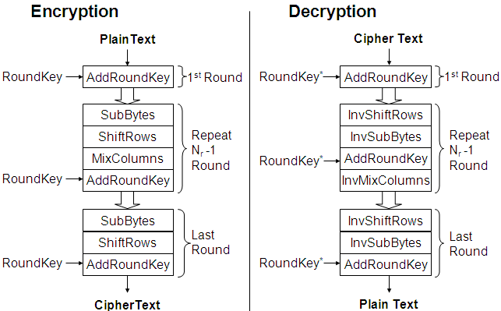
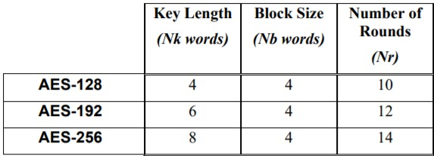
AES Flowchart
Types of
AES

Slide 5
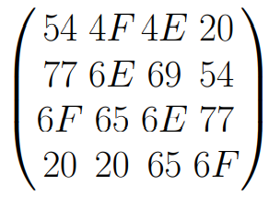
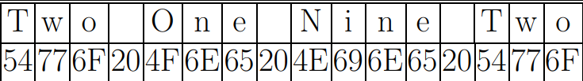
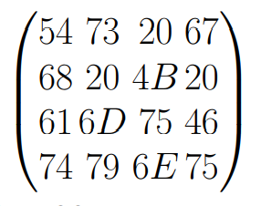
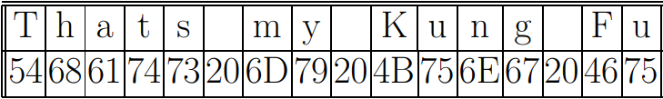
Text =
Key =

Slide 6
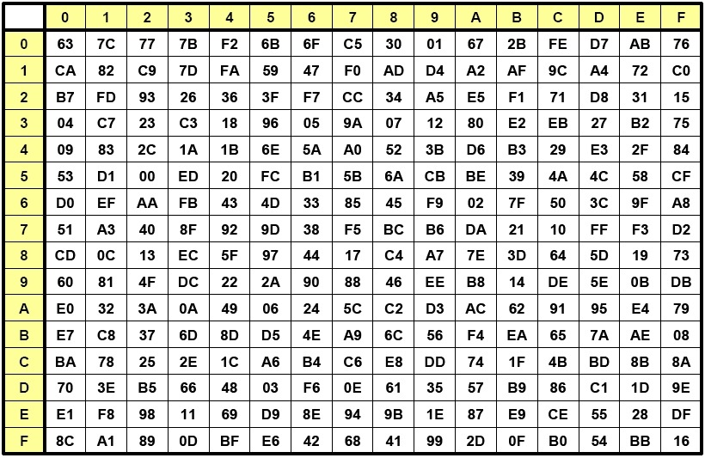
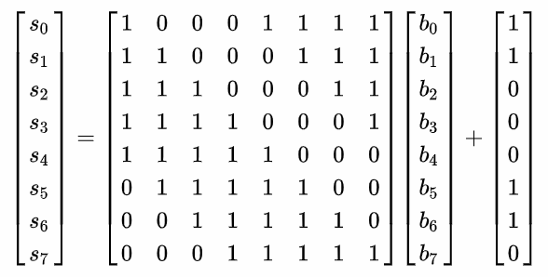
Substitution Box (rijndael S-Box)
S(b) = Ab + c

Slide 7
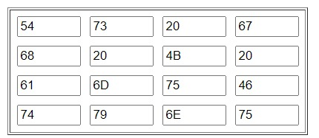
Round key - 0
Key =
In this matrix each column is represented by W[0], W[1], W[2], W[3] respectively.
w[0] = (54, 68, 61, 74)
w[2] = (20, 4B, 75, 6E)
w[1] = (73, 20, 6D, 79)
w[3] = (67, 20, 46, 75)

Slide 8


Key expansion
Step 1:
Step 2: Byte substitution using s-Box:
Step 3: XOR of round constant and w[3]
Step 4: After finding g(w[3]) we will find new keys using following methods
W[i] = w[i-1] XOR w[i-4]

Slide 9
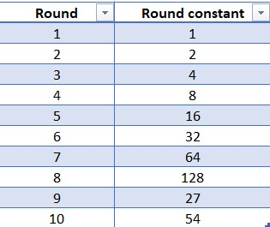
Round constant

Slide 10
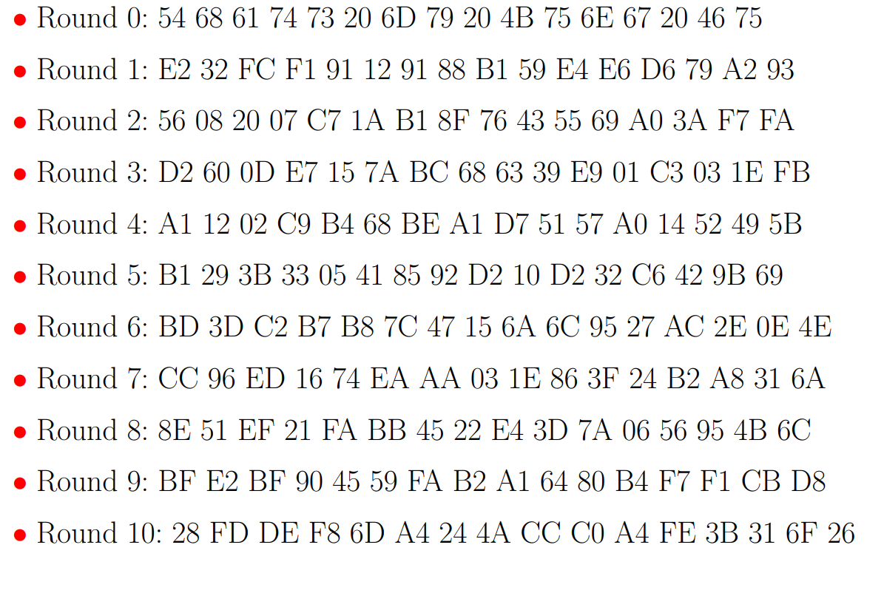
All Round keys
Similarly the same process repeated 10 times and generate 40 words.

Slide 11
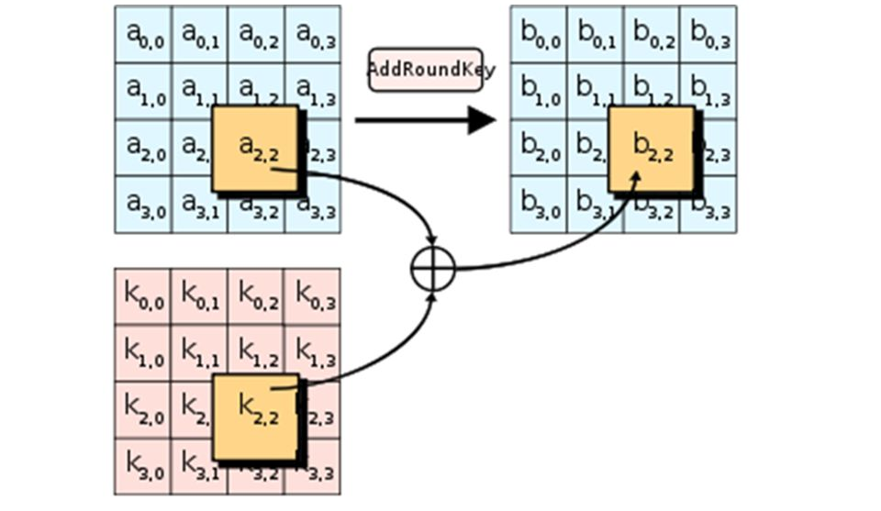
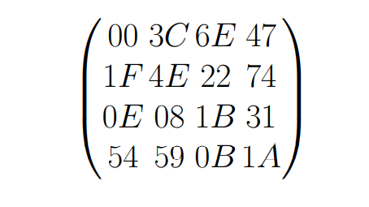
XOR between State matrix and round key 0
Add Round Key
After we come up with New State Matrix:
New State Matrix =

Slide 12
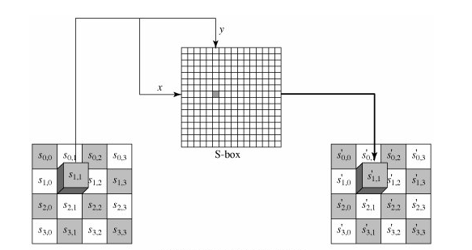
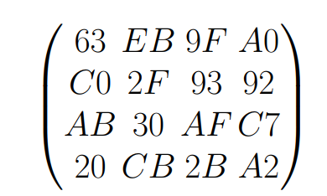
Substitution bytes
Matrix after Substitution

Slide 13
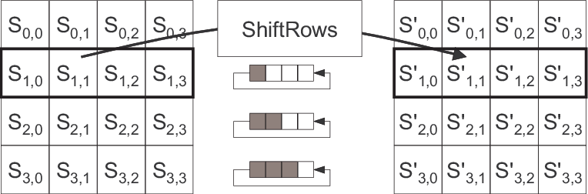
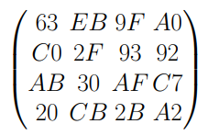
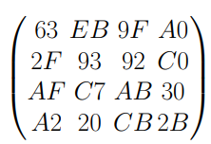
Row Shift
rows are shifted cyclically to the left except the first row, because it’s remain unchanged.

Slide 14
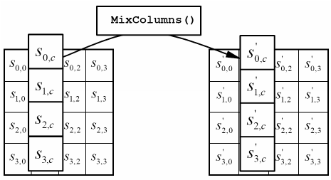
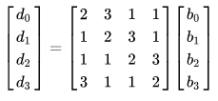
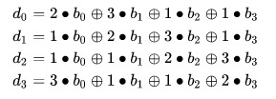
Mix Column
Circulant MDS MATRIX

Slide 15
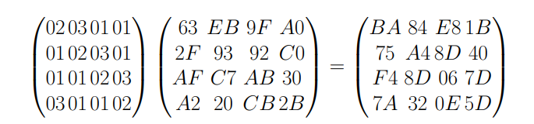
Mix Column multiplies fixed matrix against current State Matrix
Each element is in
GF(2⁸)
Coefficients are in
GF(2)
BA is result of (02 • 63) ⊕ (03 • 2F) ⊕ (01 • AF) ⊕ (01 • A2):
02 • 63 = 00000010 • 01100011 = 11000110
03 • 2F = (x + 1) •(x⁵ + x³ + x² + x + 1) = x • (x⁶ + x⁴ + x³ + x² + x) + x⁵ + x³ + x² + x + 1 = x⁶ + x⁵ + x⁴ + 1
03 • 2F = (02 • 2F) ⊕ 2F = (00000010 • 00101111) ⊕ 00101111 = 01110001
01 • AF = 1 • (x⁷ + x⁵ + x³ + x² + x + 1) = x⁷ + x⁵ + x³ + x² + x + 1
01 • AF = AF = 10101111 and 01 • A2 = A2 = 10100010
Now we have to do XOR of the above result;
11000110
+01110001
+10101111
+10100010
10111010
1 = 1
2 = x
3 = x + 1
02 • 63 = X • (x⁶ + x⁵ + x + 1) = x⁷ + x⁶ + x² + x

Slide 16
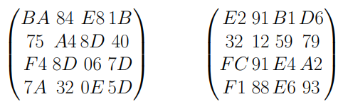
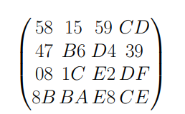
Add round key - Round-1
State Matrix and Round key No.1 Matrix:
⊕
This process will be done in the same way up to 10 rounds and after the 10th round we will get the encrypted cipher text.
Encrypted ciphertext:

Slide 17
Decryption
Decryption is carried out in similar fashion as of encryption with the help of inverse processes i.e. inverse s-box, right row shift, inverse mix-column and add round constant with reverse key schedule.

Slide 18
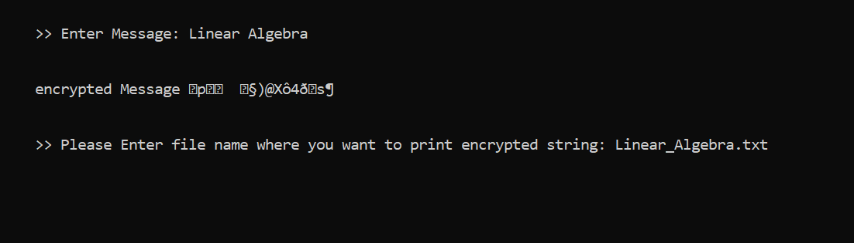

Input
Input can be text or file (image, videos, pptx, audio, docx, xlsx, etc).

Slide 19
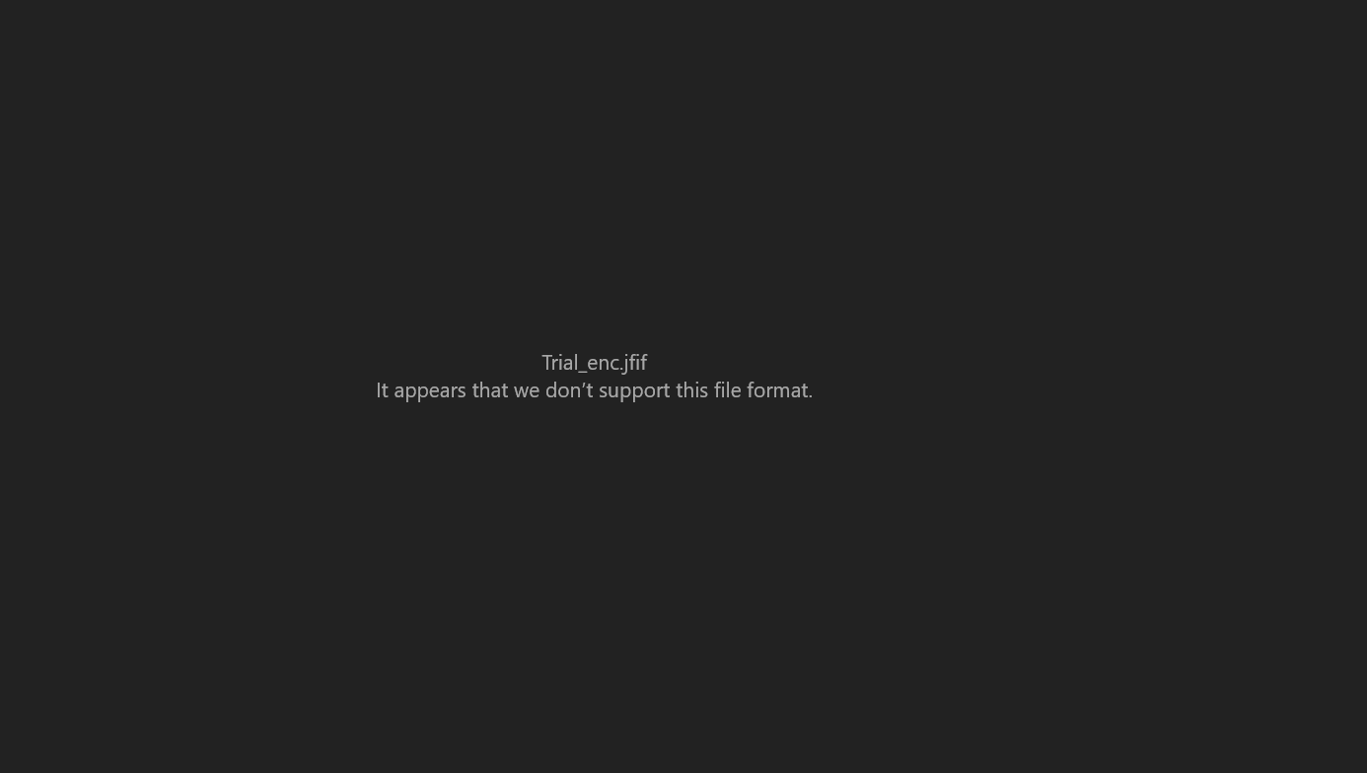
Results
Encrypted Image
Decrypted Image

Slide 20
Libraries which we used in project
1. import os(used for to check the file was empty or not)
2.import base64(used for encoding binary data into ASCII characters and decoding such encodings back to binary data)
3. import sys(used for performing clear screen)
4. import stdiomask(used for print ‘*’ while entering the password to make it better)
5. import ctypes(used for print warning message while entering invalid credentials)
6. Import getpass (used for login system)
7. Import sleep

Slide 21
Conclusion
There is currently no evidence that AES has any weakness making attack other than exhausting search, example brute-force. So, it cannot encrypt or decrypt by anyone except user, who has the key for decrypt. The reason behind this was that each and every data has a key associated with it which is only known by user. So, no one can decrypt it.
Different files have different files format hence, dealing with each file format can be hideous. Hence, we are using string for carrying out the process of encryption and decryption of many extension files such as (image, videos, pptx, audio, docx, xlsx, etc) using same strategy.

Slide 22
References
1.Benvenuto, C. J. (2012, may 31). Galois Field in Cryptography. Retrieved from https://sites.math.washington.edu/:
https://sites.math.washington.edu/~morrow/336_12/papers/juan.pdf
2. medium. (2019, november 08). Real Life Applications. Retrieved from medium.com: https://medium.com/@prashanthreddyt1234/real-life-applications-of-cryptography-162ddf2e917d
3. N/A. (2001, november 26). Specification for the AES. Retrieved from https://csrc.nist.gov/: https://csrc.nist.gov/csrc/media/publications/fips/197/final/documents/fips-197.pdf
4. springer. (2020, july 05). MixColumns Coefficient Property. Retrieved from springer.org: https://link.springer.com/chapter/10.1007/978-3-030-51938-4_6
5. wikipedia. (2009, october 23). Advanced Encryption Standard. Retrieved from wikipedia.org: https://en.wikipedia.org/wiki/Advanced_Encryption_Standard
6. wikipedia. (2020, April 07). MDS_Matrix. Retrieved from wikipedia.org: https://en.wikipedia.org/wiki/MDS_matrix

Slide 23
Thank You

